Slide 1

Mystic Realm
Made by: Szabolcs Patai, Patrik Máté, Zsolt Szilágyi

Slide 2


Website
Programmes:
Visual Studio Code
Pixlr
Programming languages:
PHP
HTML
CSS

Slide 3
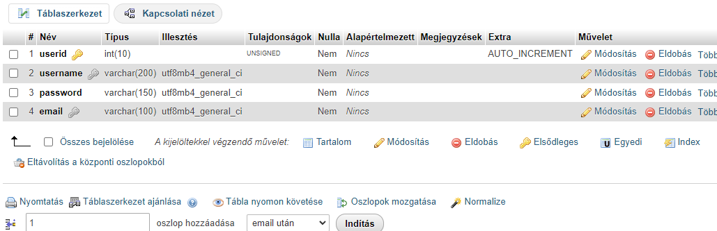
Database construction
Userid
Username
Password
Email

Slide 4
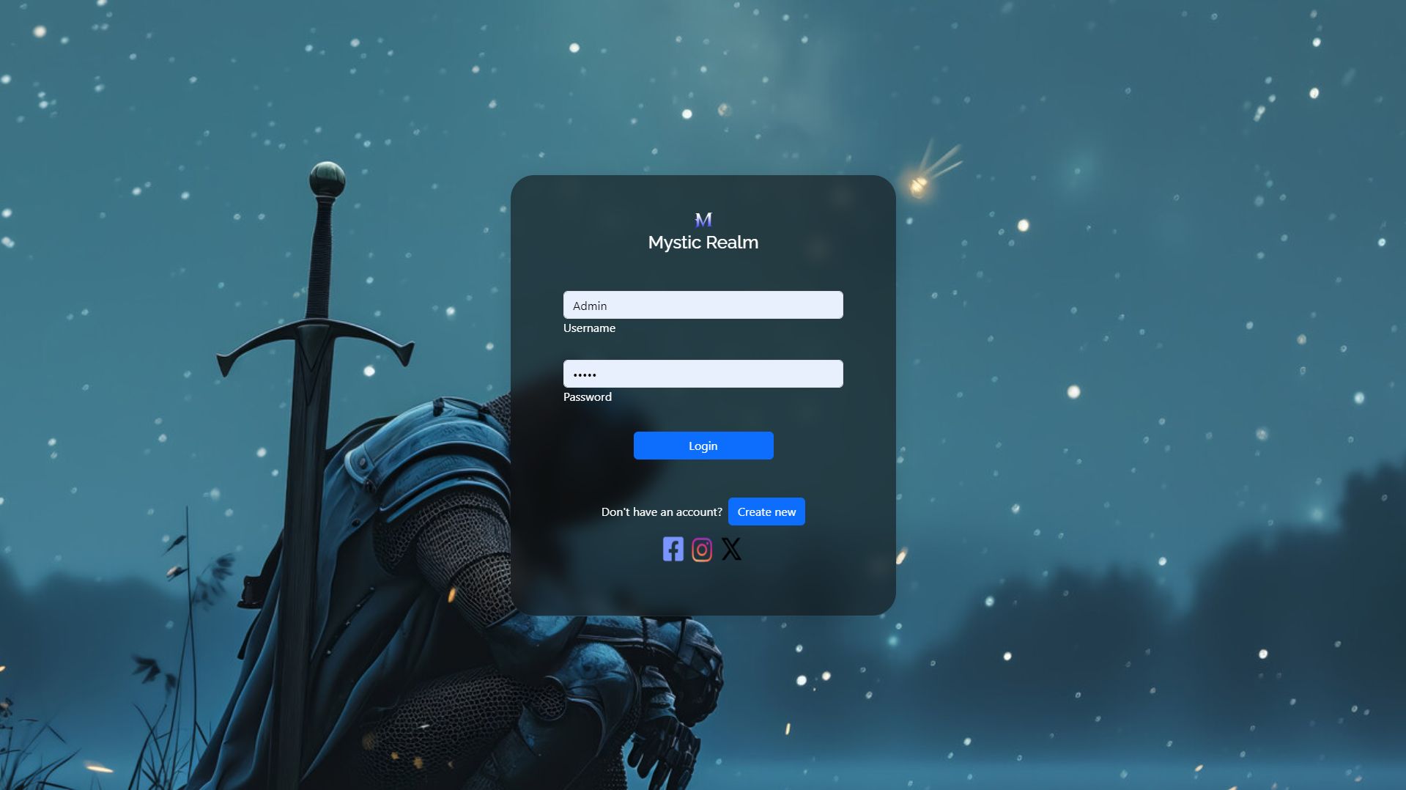

Registration and login
Outer Registration/Login
Datebase Contact
User-Friendly design
Feedback in case of error

Slide 5
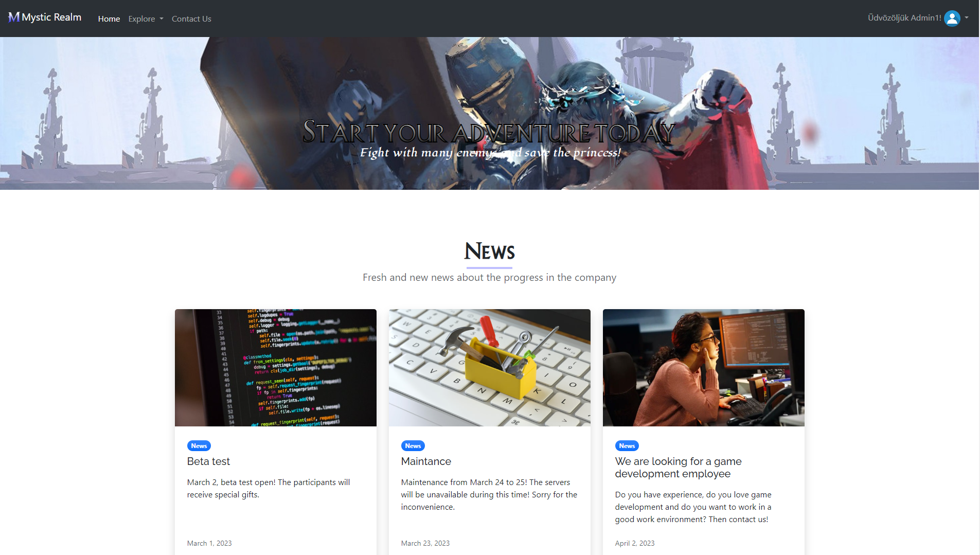
Website
User-Friendly
Modern style
Dynamic elements
Responsive

Slide 6
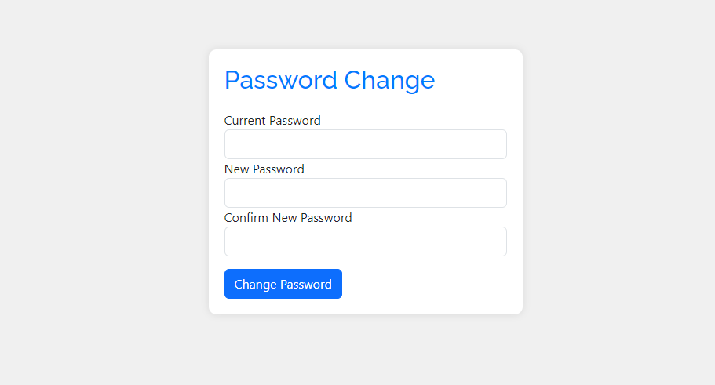
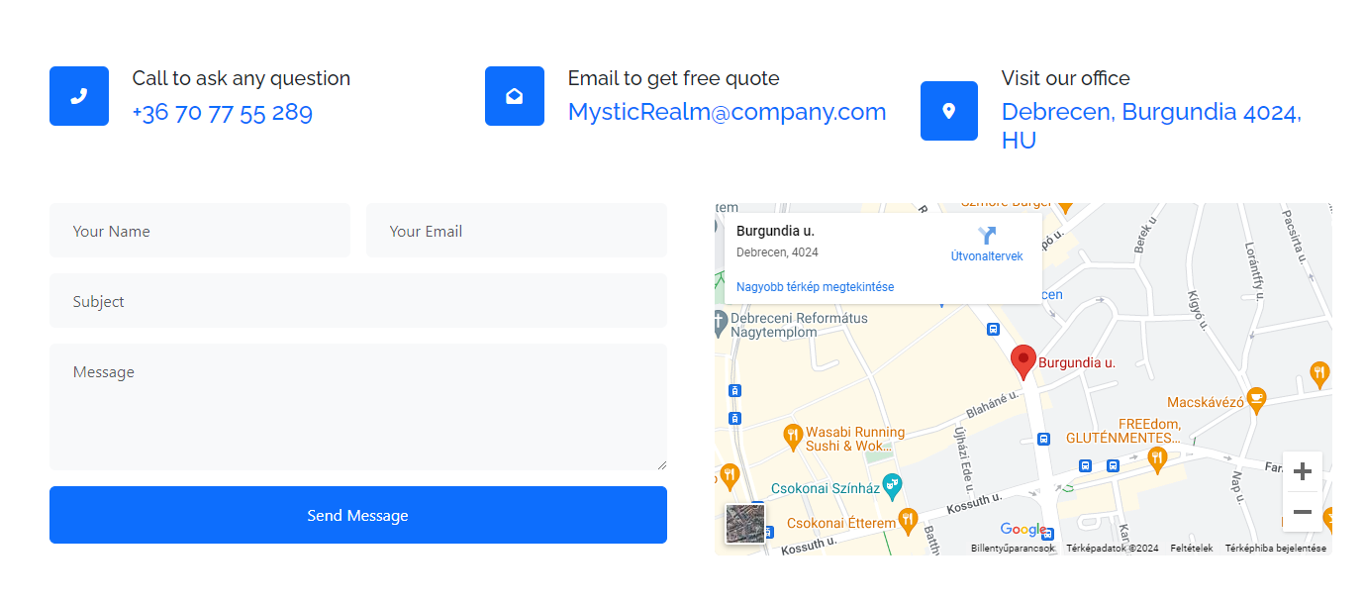
Website
Password Change
Contact us
Data protection

Slide 7

Game
Programmes:
Visual Studio
Visual Studio Code
Programming languages:
C#
PHP

Slide 8
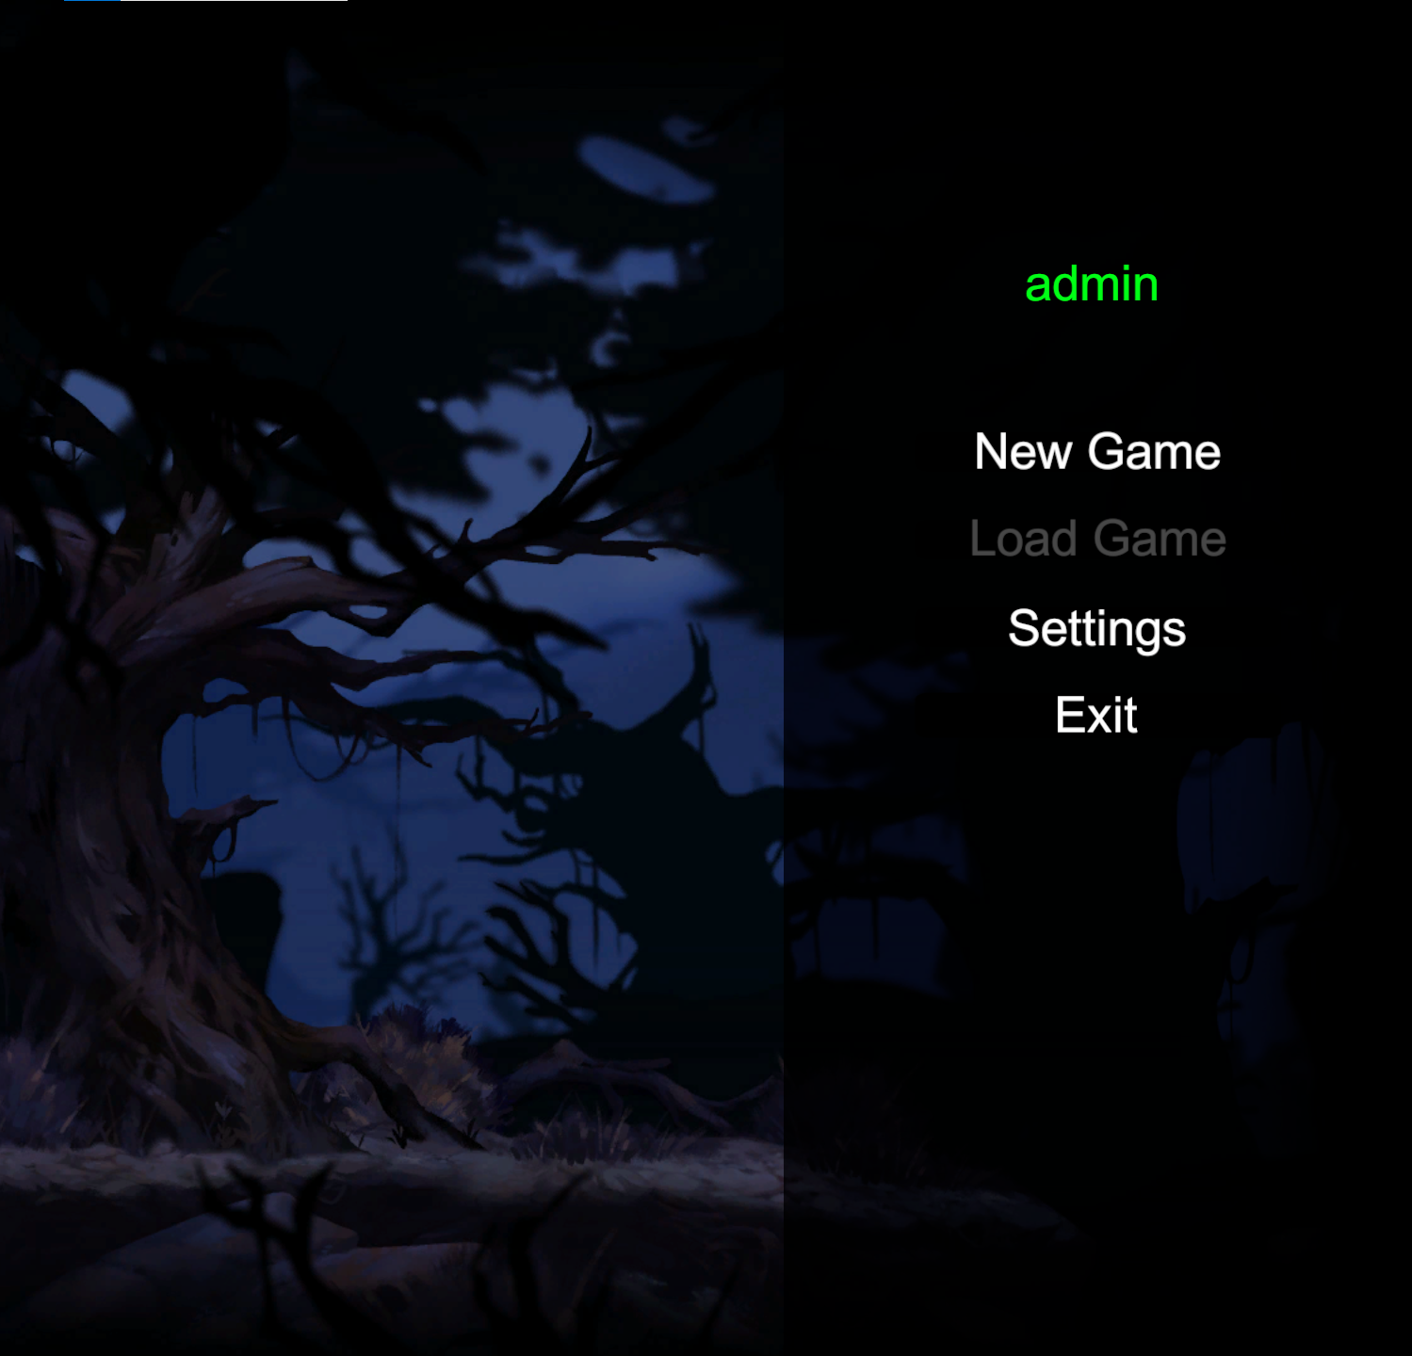
Menu
Registration
Login
New Game
Load Game
Settings
Exit

Slide 9
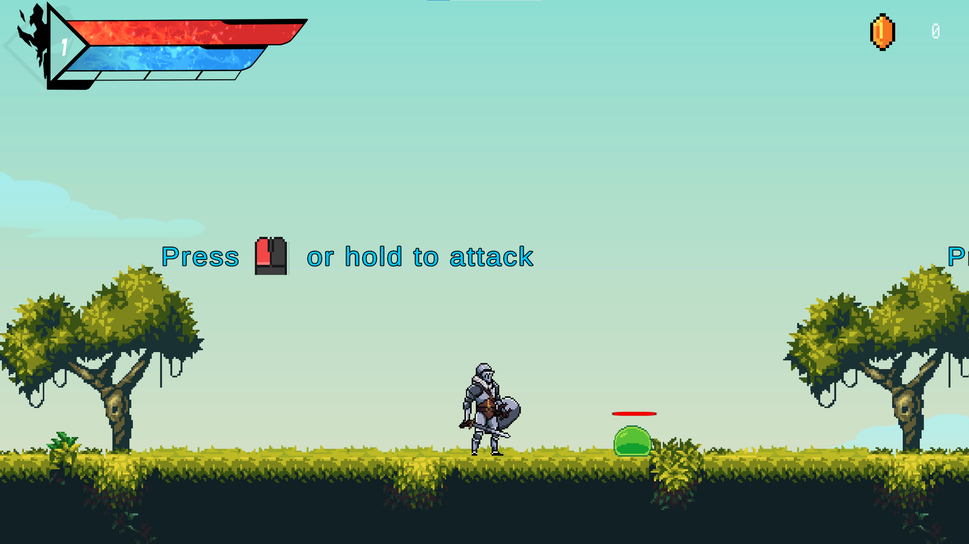
Health
Mana
Coin
Level
Experience point

Slide 10
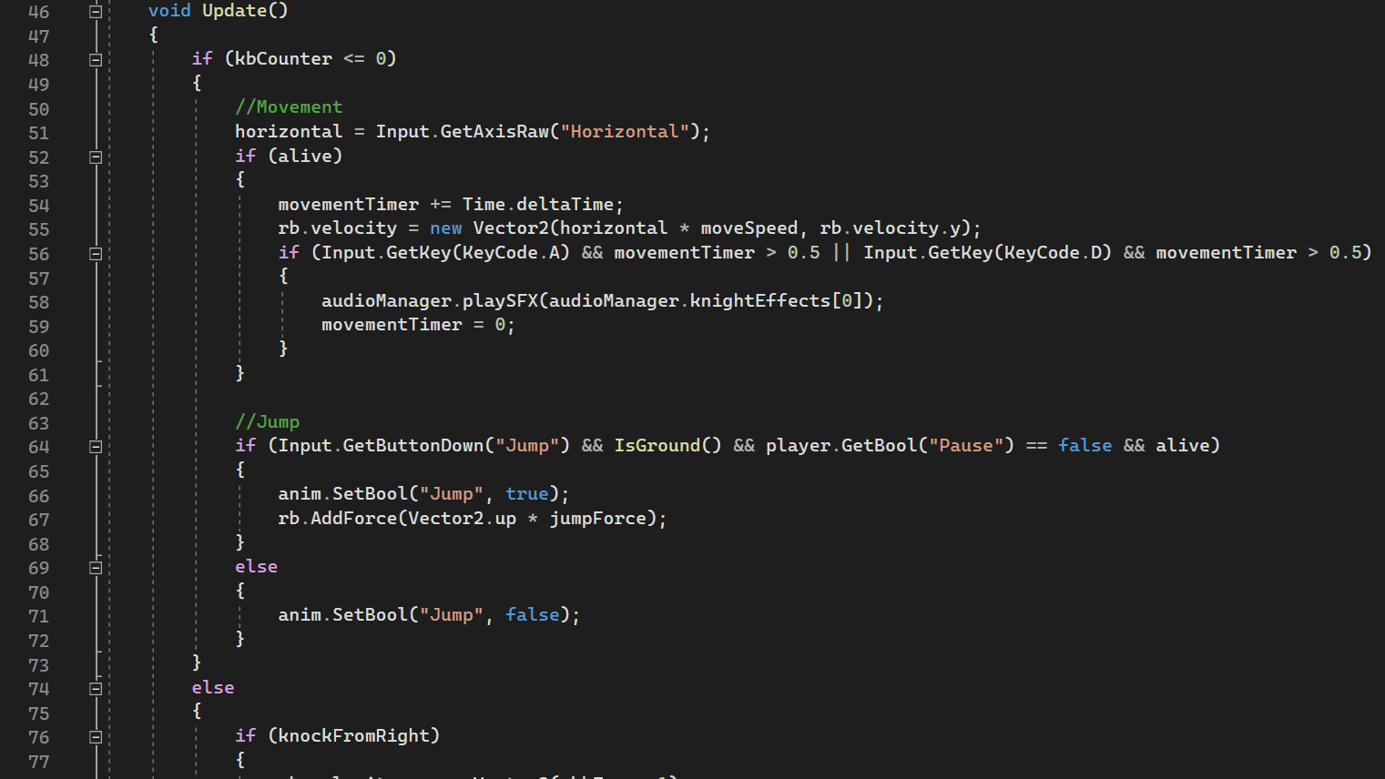
Code snippet

Slide 11
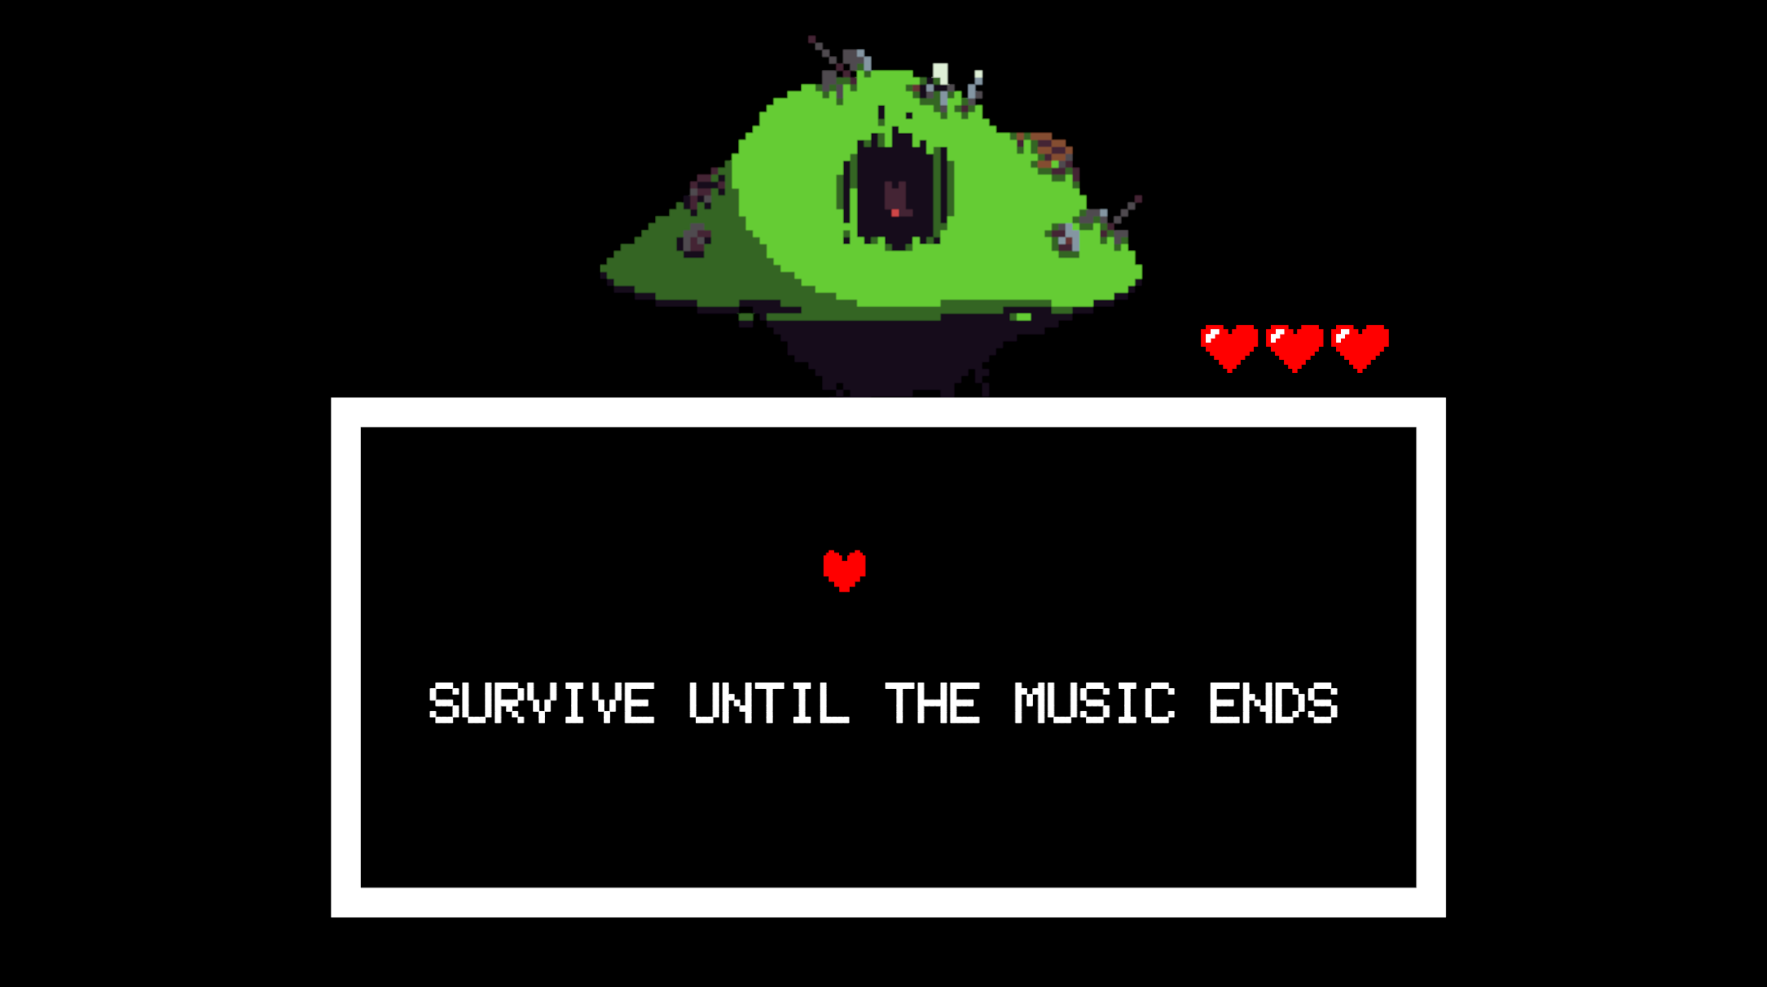
UnderTale
Reference
Music
Laser
Movement

Slide 12
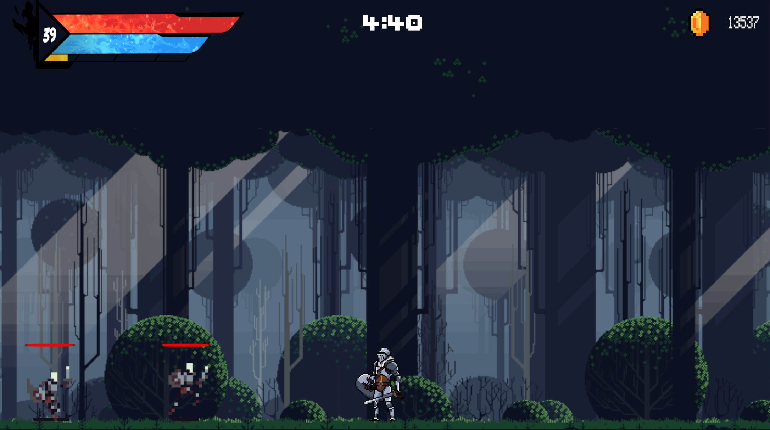
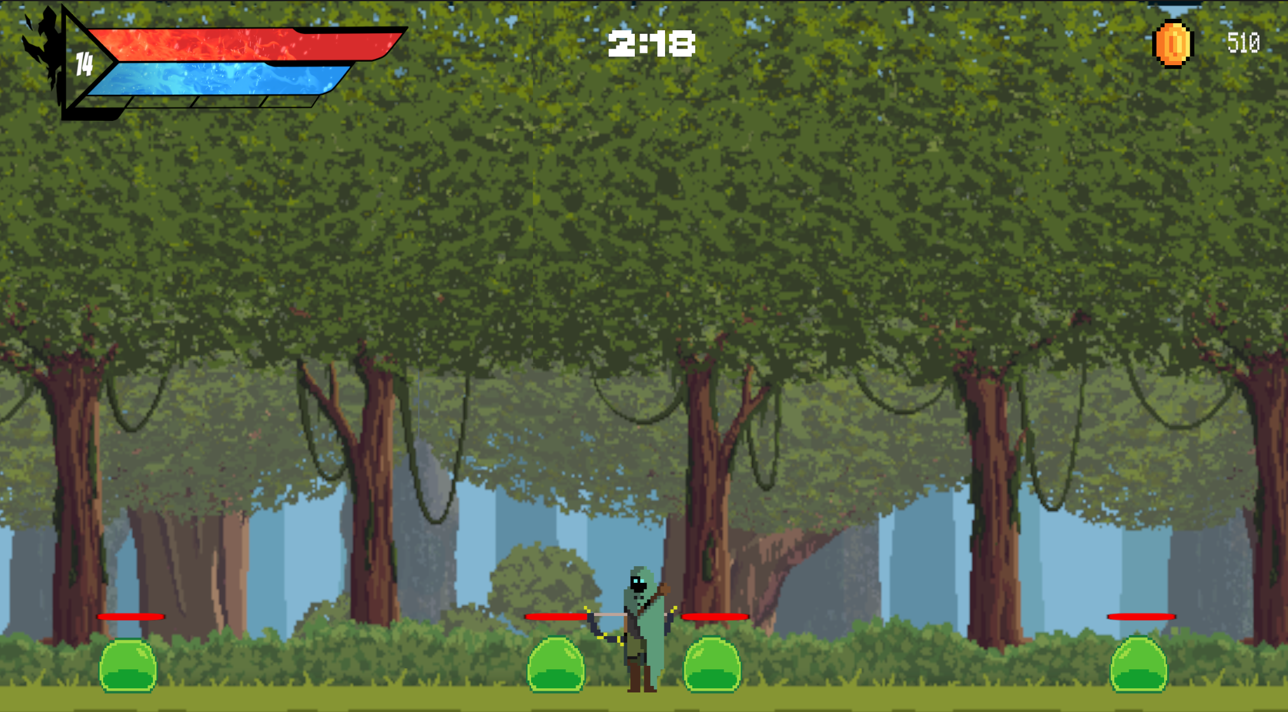
Arena
5 Minutes
Increasing difficulty
Characters
Enemies

Slide 13
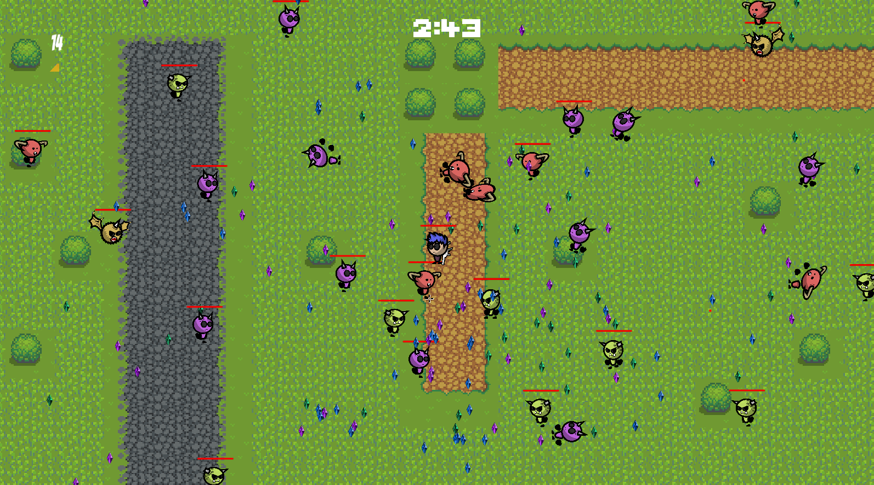
Map 3
Increasing difficulty
Aim
Difficulty change

Slide 14
Character, weapons and enemies
Upgradable stats
Pistol
Rifle
4 enemies

Slide 15
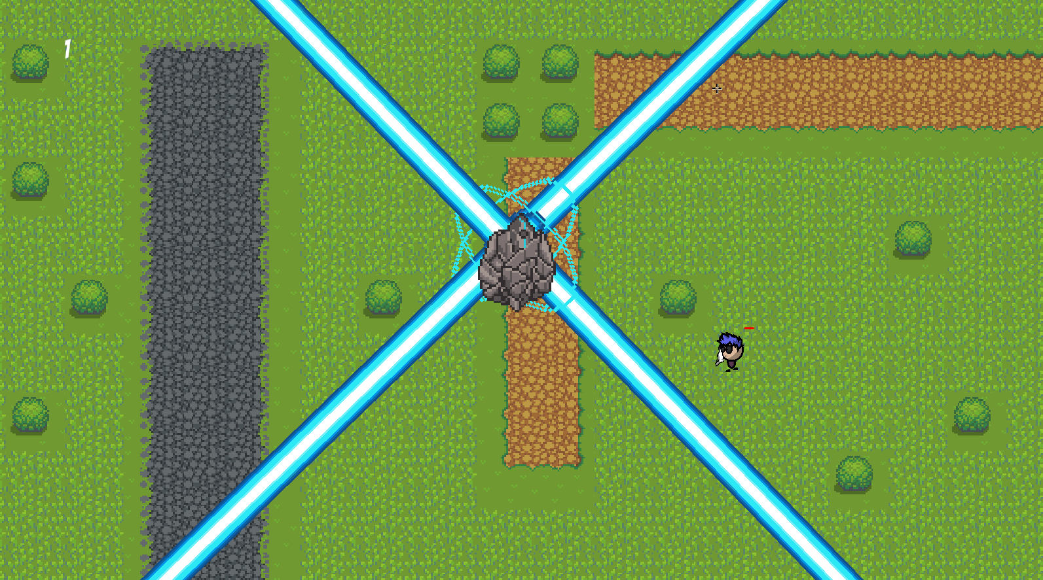
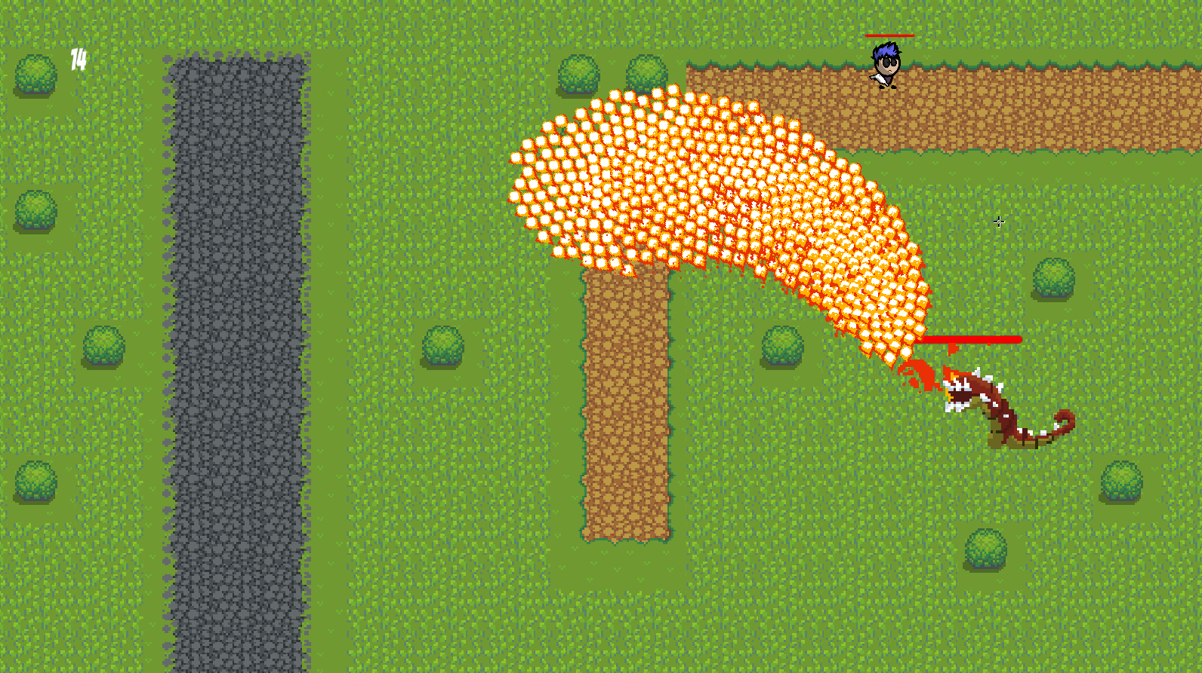

Bosses
2 Boss
Reward
Abilities
Time

Slide 16
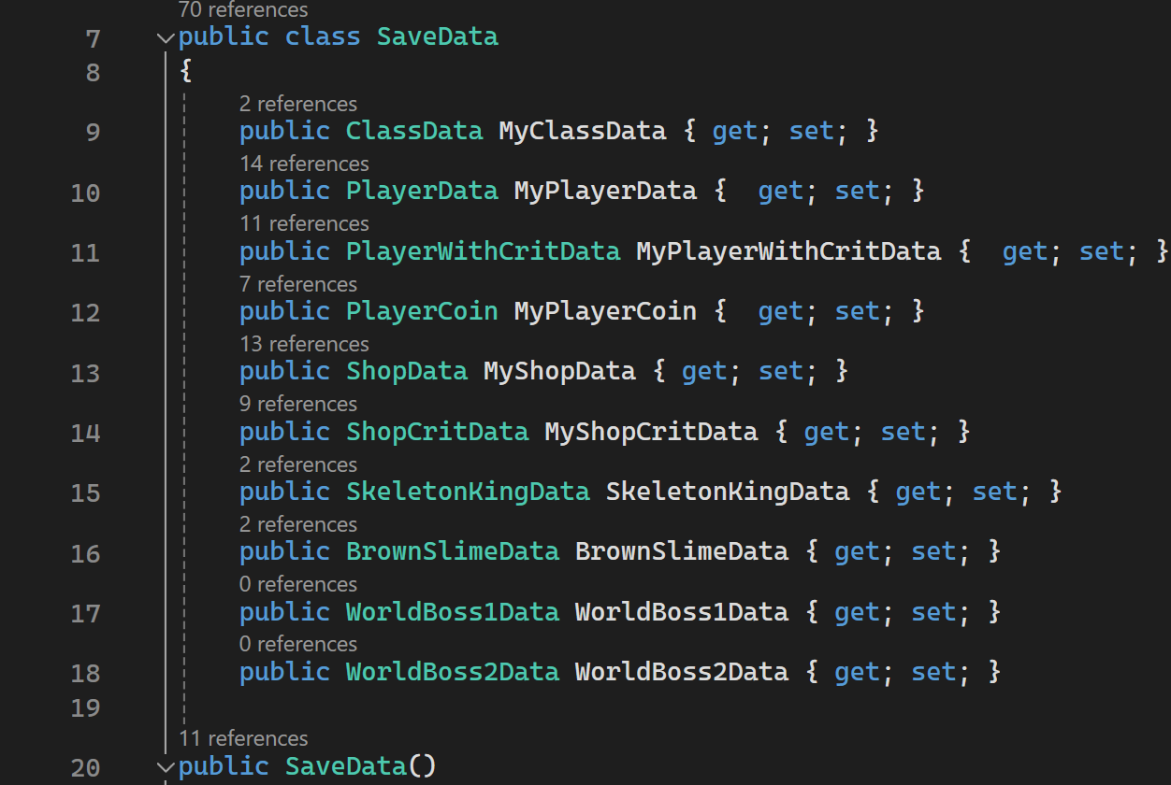
Save
Files
Character
Shop
Enemies

Slide 17
Thank you for your attention

